Slide 1
Module 4 Challenge Lab - Creating a Dynamic Website for the Cafe
Made for Professor Lanham A. by Amrit Singh

Slide 2
AGENDA
Accessing the AWS management console
Task 1: Analyzing the existing EC2 instance
Task 2: Connecting to the IDE on the EC2 instance
Task 3: Analyzing the LAMP stack environment and confirming that the web server is accessible
Task 4: Installing the café application
Task 5: Testing the web application
Task 6: Creating an AMI and launching another EC2 instance
Task 7: Verifying the new café instance

Slide 3
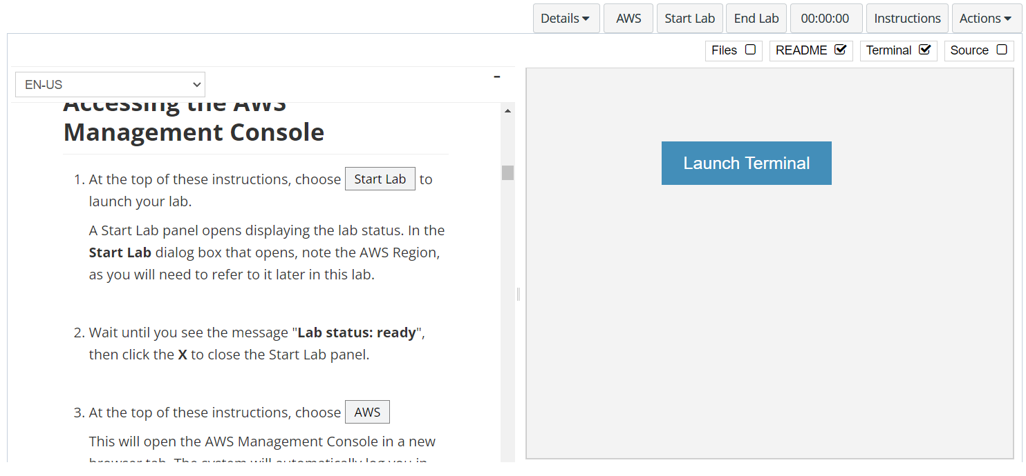
In aws labs click on start lab

Slide 4
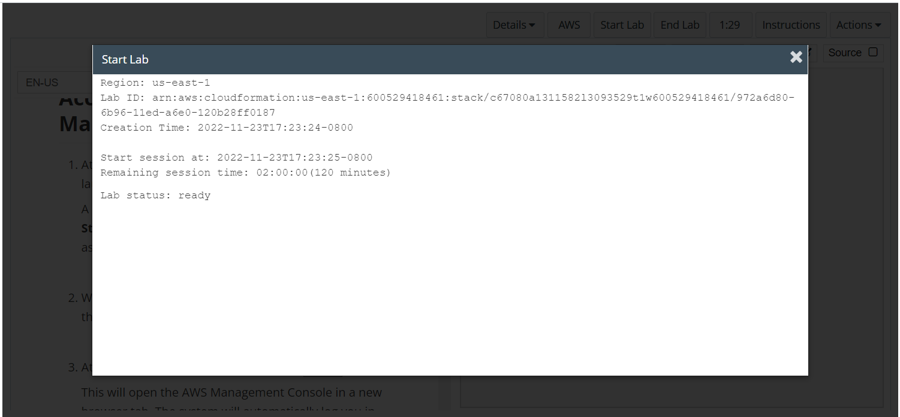
Wait to see lab ready status in the window then press x and click on aws to launch console

Slide 5
Task 1: Analyzing the existing EC2 instance

Slide 6
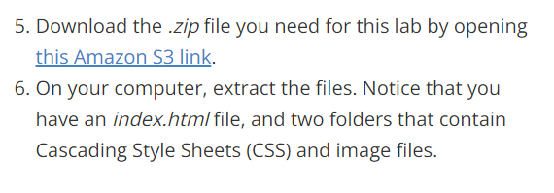
Download the files from aws labs by clicking on the link and extract the files
Click on the link

Slide 7
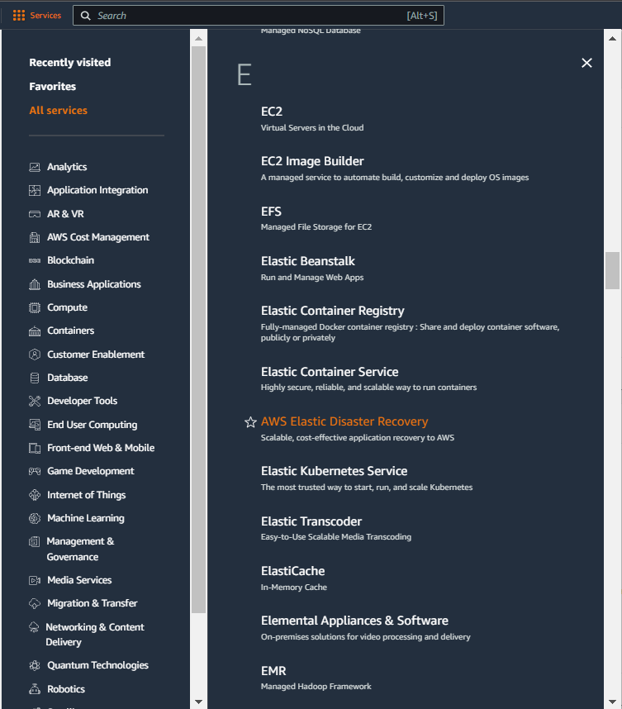
Select services and then click on ec2 button
Click on the Services button
Click on the ec2 button

Slide 8
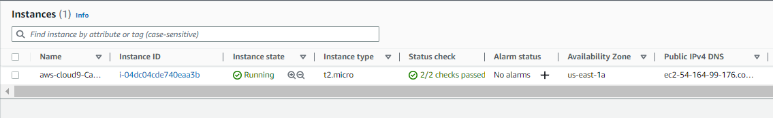
Aws-cloud9 instance is running

Slide 9
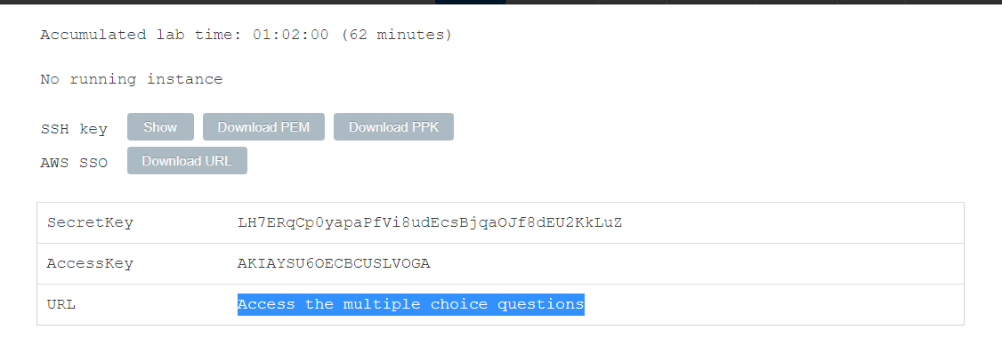
In the aws labs page click on details > aws: show> Access the multiple choice questions and answer the first 4 questions

Slide 10
Task 2: Connecting to the IDE on the EC2 instance

Slide 11
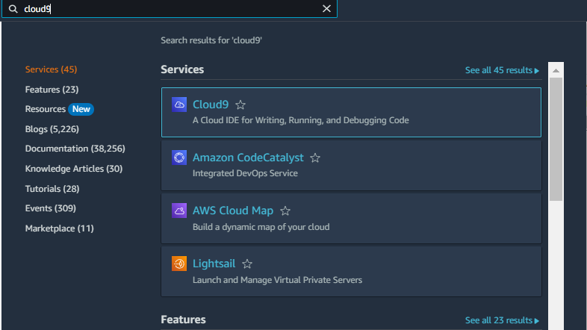
Search for cloud9 in the searchbar
Click on the cloud9 button

Slide 12
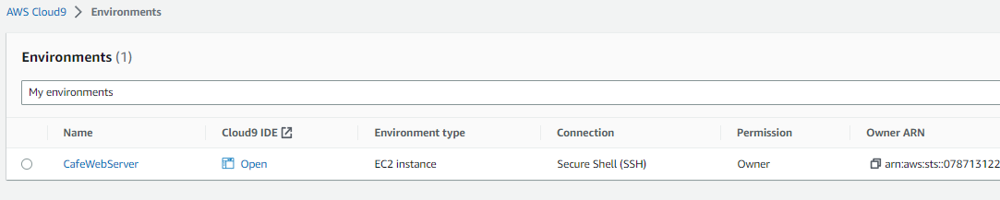
Click on open button corresponding to cafewebserver
Click on create bucket button

Slide 13
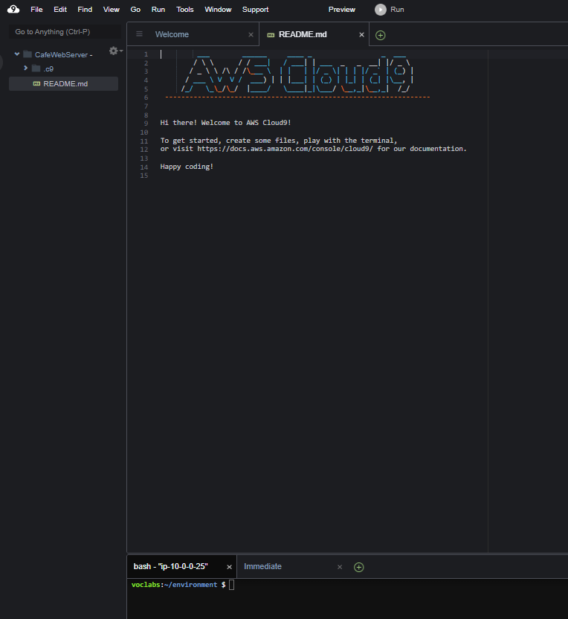
Cloud9 ide opens up with the bash terminal along with filebrowser and file editor

Slide 14
Task 3: Analyzing the LAMP stack environment and confirming that the web server is accessible

Slide 15
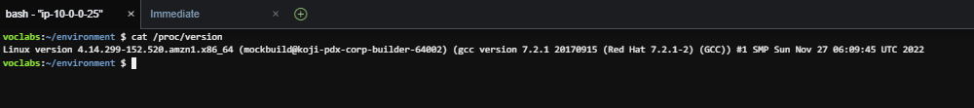
Observe the os version by typing the command in the bash terminal

Slide 16
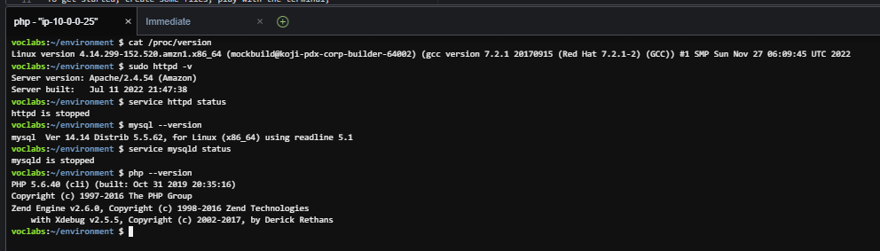
Run the commands for checking the status of webserver and database to see that they are not currently running

Slide 17
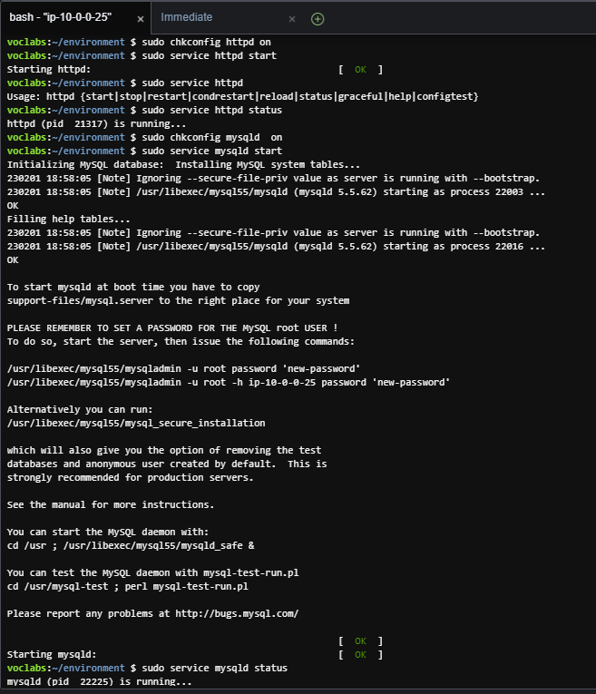
Run the following bash scripts to turn on the webserver and sql database

Slide 18
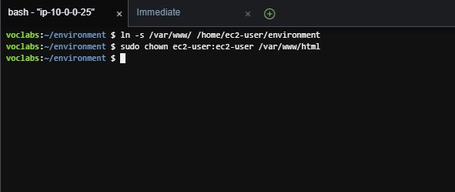
Configure the ec2 instances to use cloud9 as the editor

Slide 19
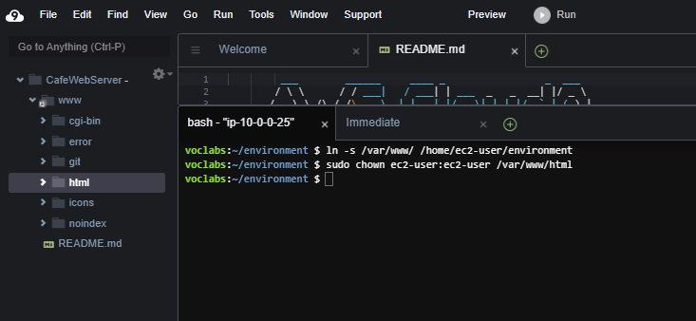
Expand the cafewebserver www in the file explorer and then select html

Slide 20
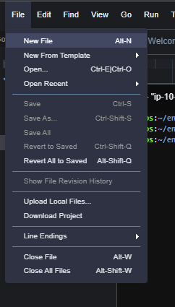
Then select file > new file

Slide 21
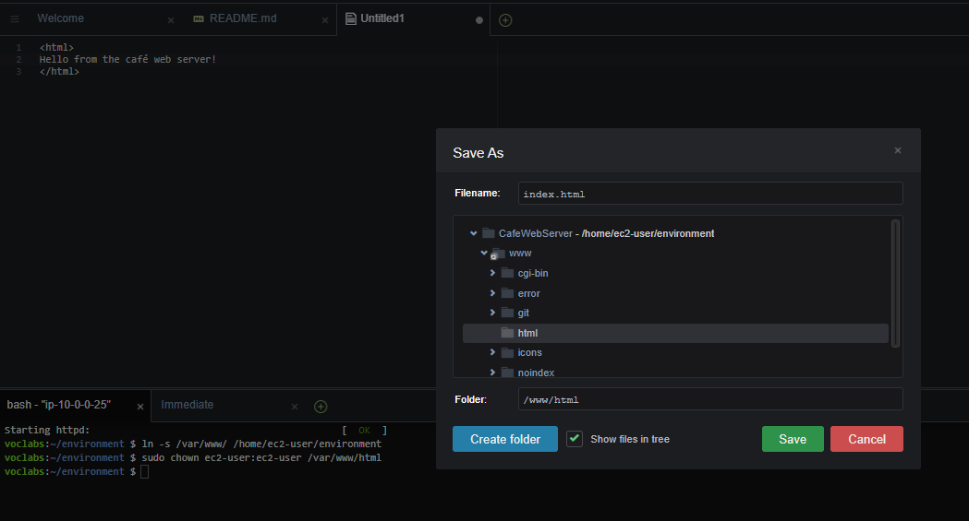
In the file opened paste the text as shown and then save the file as index.html in the html folder
File save properties
HTML code

Slide 22
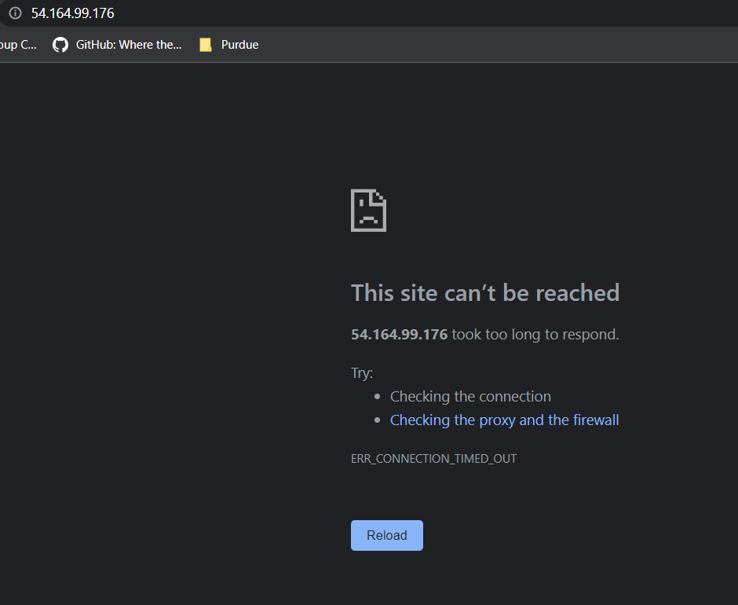
Try to open the ip address of the ec2 instance in the browser window

Slide 23
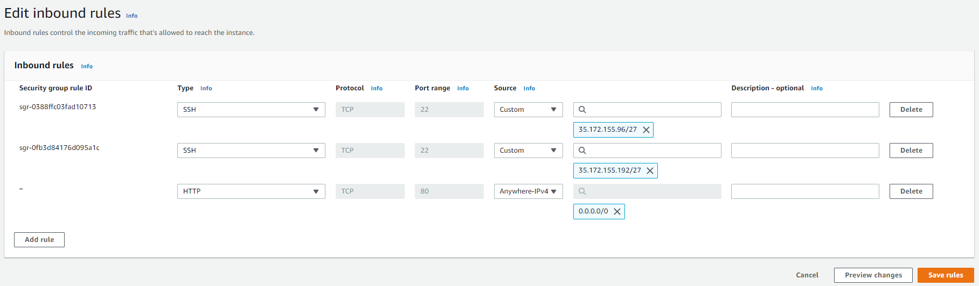
Edit the inbound rule of the security group of the ec2 instance to allow traffic on port 80 from anywhere to make your website accessible

Slide 24
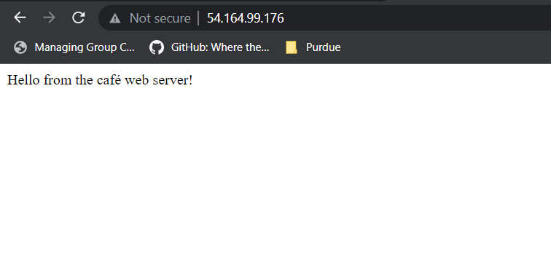
Reload the page to get the webserver to respond
Note: Ensure that you are entering HTTP in the browser and not HTTPS, or you can edit the inbound rule to get HTTPS as well

Slide 25
Task 4: Installing the café application

Slide 26
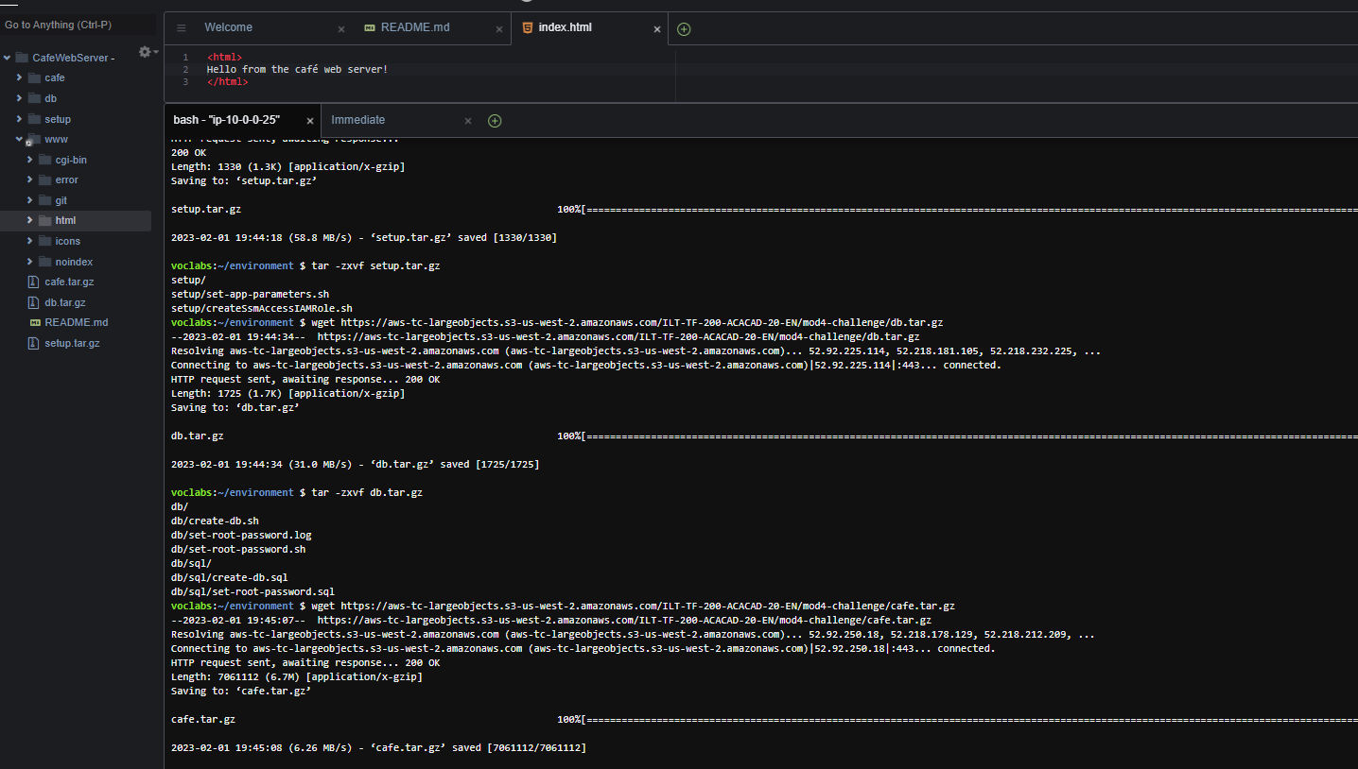
Run the command from the aws labs to download zip files and create directory

Slide 27
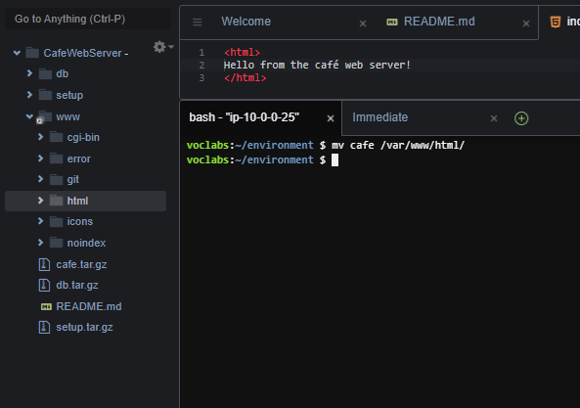
Copy the files over to web server root

Slide 28
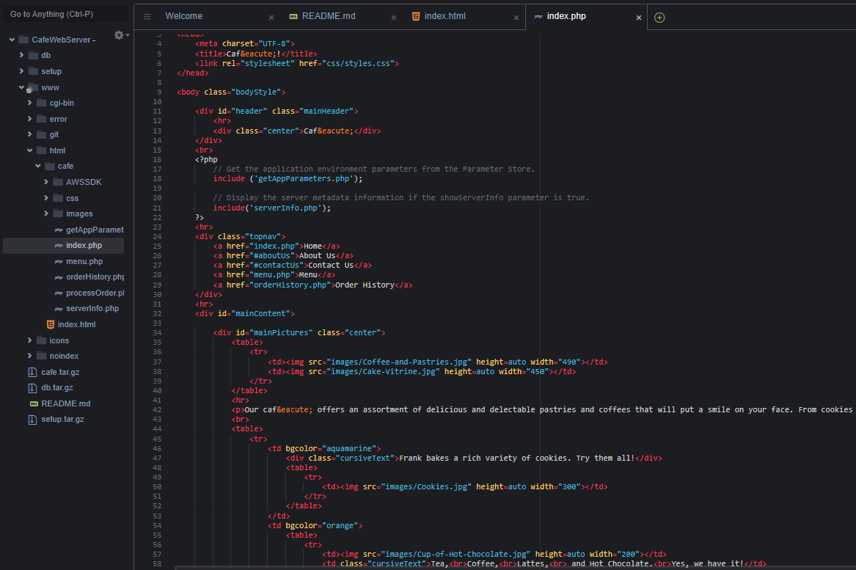
Open the index.php script from html > café > index.php

Slide 29
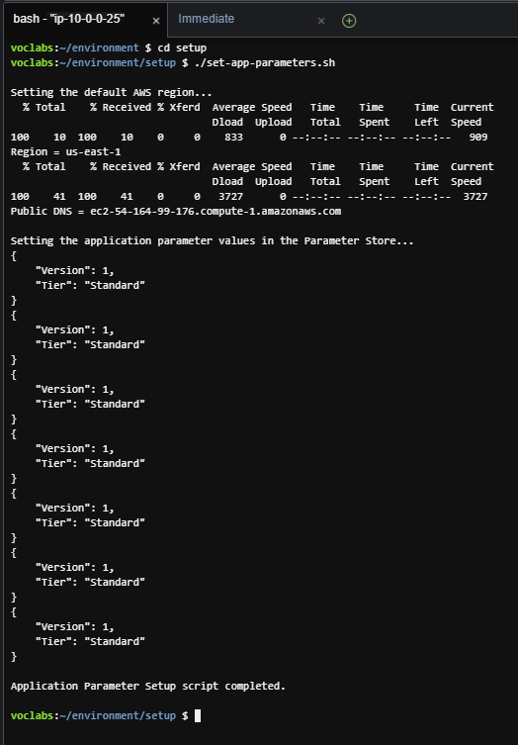
Set the application parameter store in the console by running the following script

Slide 30
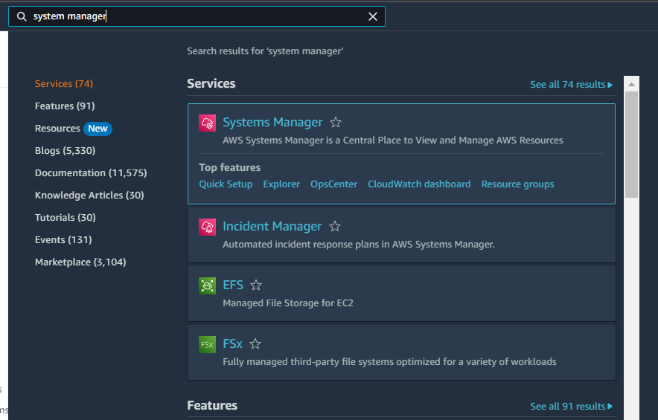
Search for system manager in the searchbar
Click on the system manager button

Slide 31
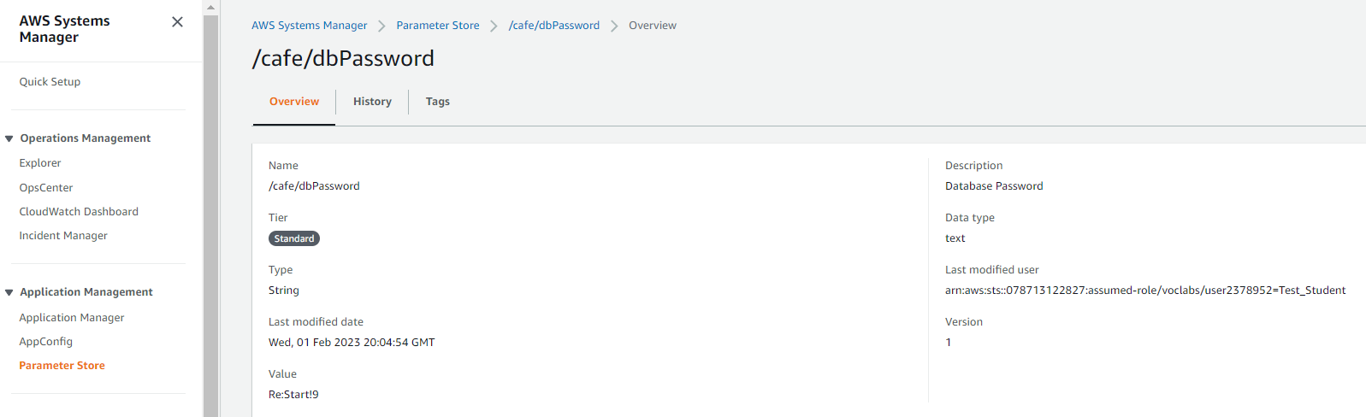
Open parameter store and save the value of café/dbpassword

Slide 32
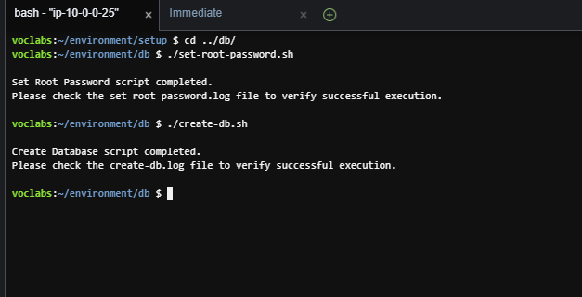
Configure the sql database to support the application by running the following commands

Slide 33
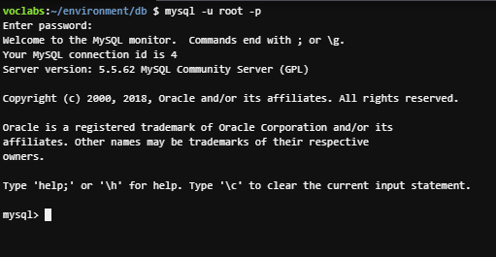
Access the mysql data base using the following code, password is sourced from parameter store

Slide 34
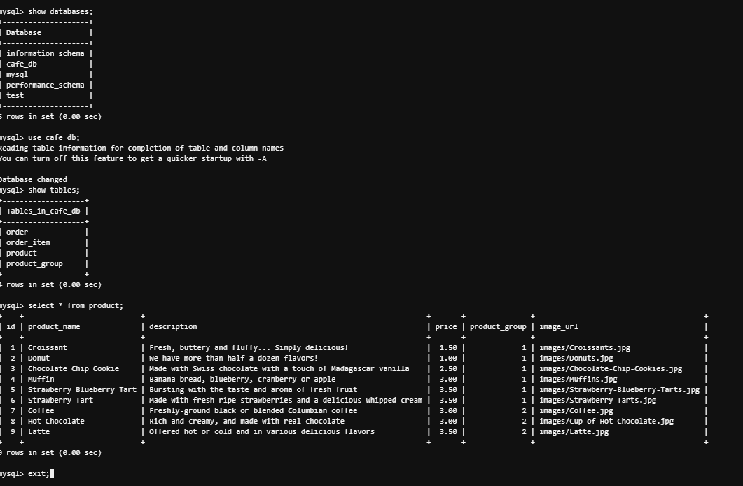
Run the sql command to see the various details stored in mysql

Slide 35
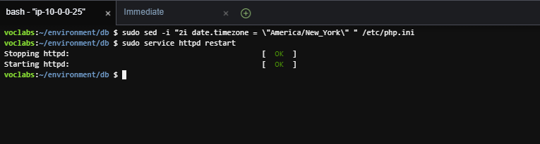
Update the timezone using the following command

Slide 36
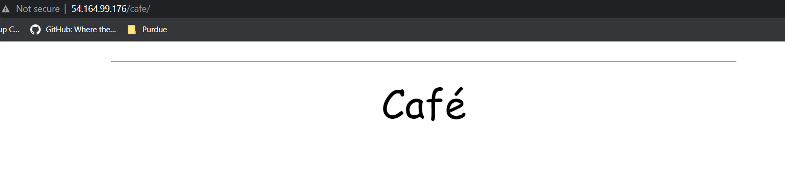
Test whether your website works, you will observe only title loads up

Slide 37
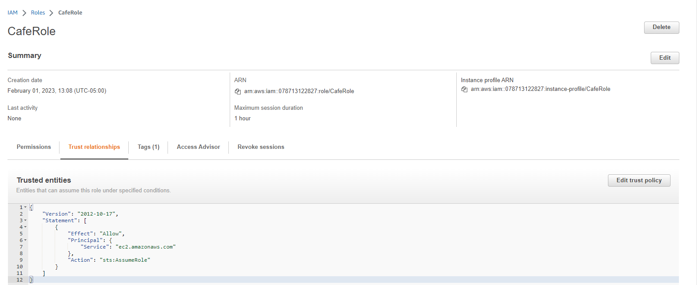
The issue is that mysql server is not accessible by the ec2 instance, hence we can see that there is a café role policy in iam that needs to be attached to ec2 instance

Slide 38
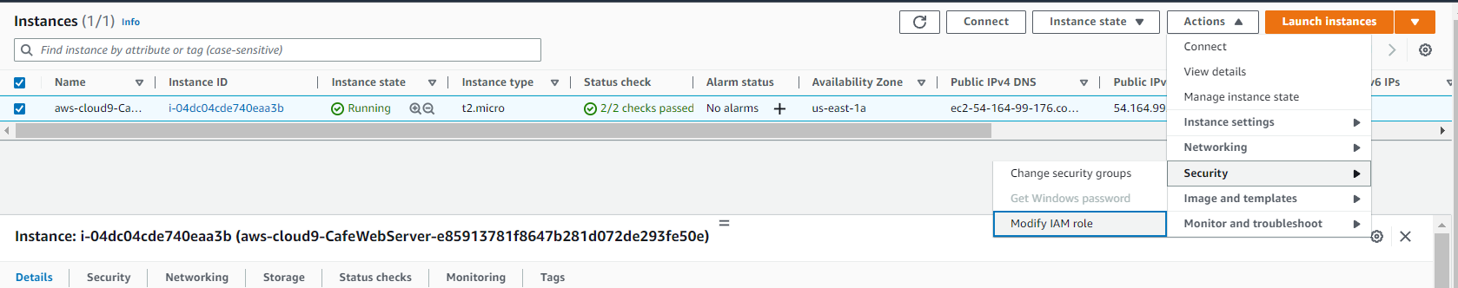
To provide access to iam role, go to instances, select cloud9 instance and then actions > security > modify iam role

Slide 39
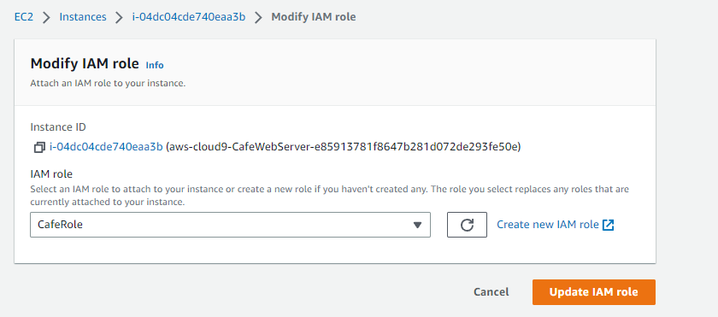
Select caferole and then click update iam role

Slide 40
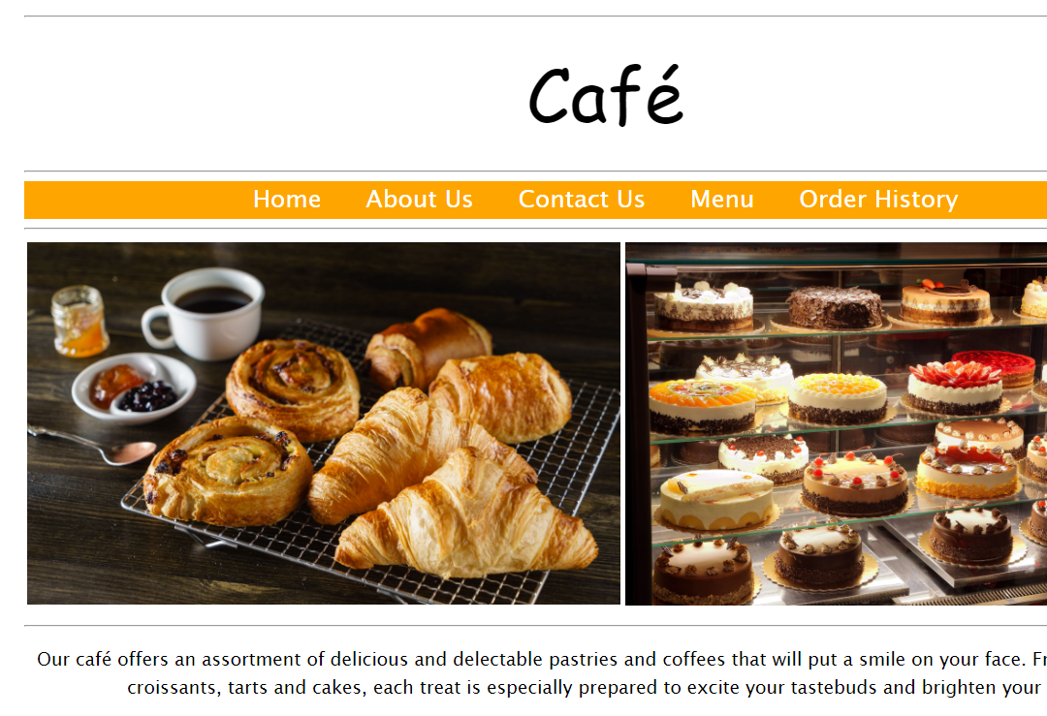
Now when we refresh the site our site loads completely

Slide 41
Task 5: Testing the web application

Slide 42
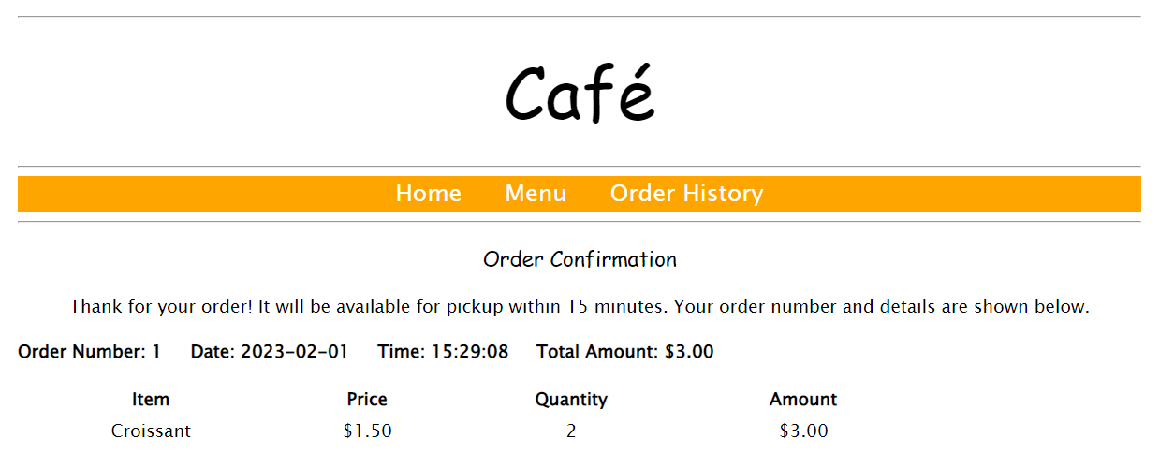
Open menu in the café website and place an order

Slide 43
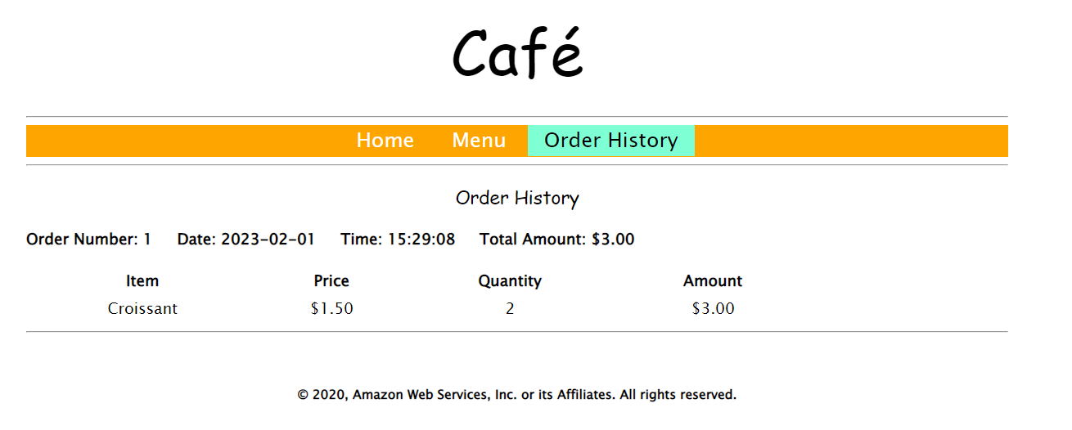
Return to the menu page and go to order history

Slide 44
Task 6: Creating an AMI and launching another EC2 instance

Slide 45
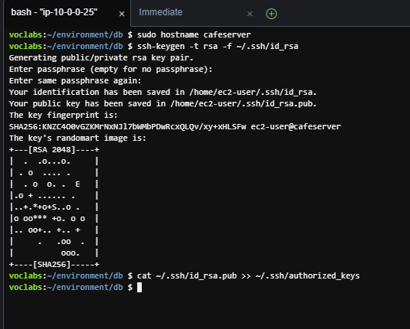
Set a static internal hostname and create key pair on ec2 instance

Slide 46
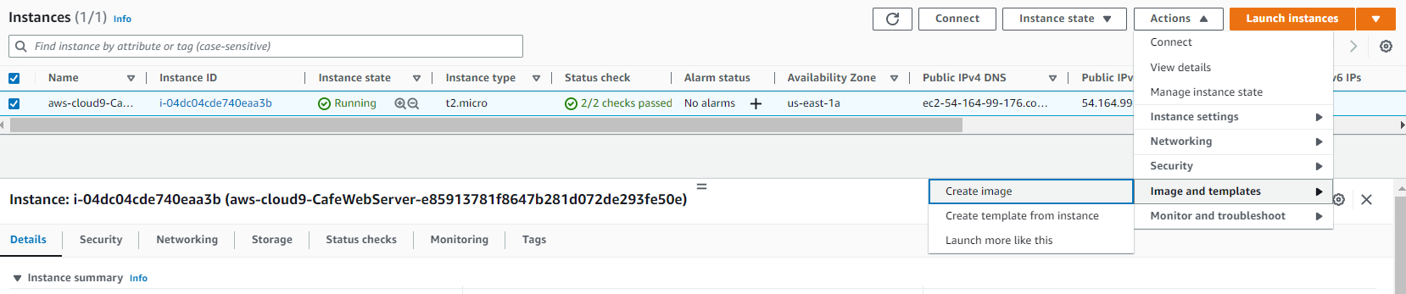
Create an image in instances by selecting the instance > actions > images and templates > create image

Slide 47
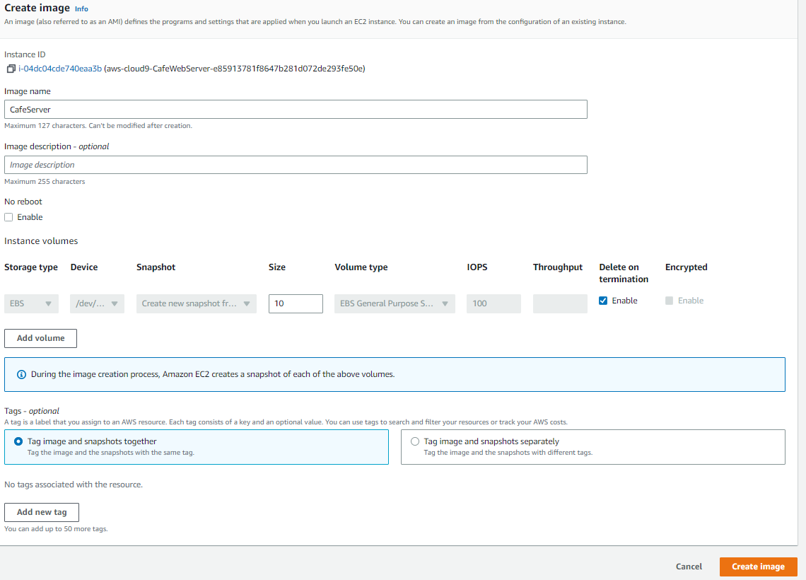
Enter cafeserver as name and then click create image

Slide 48
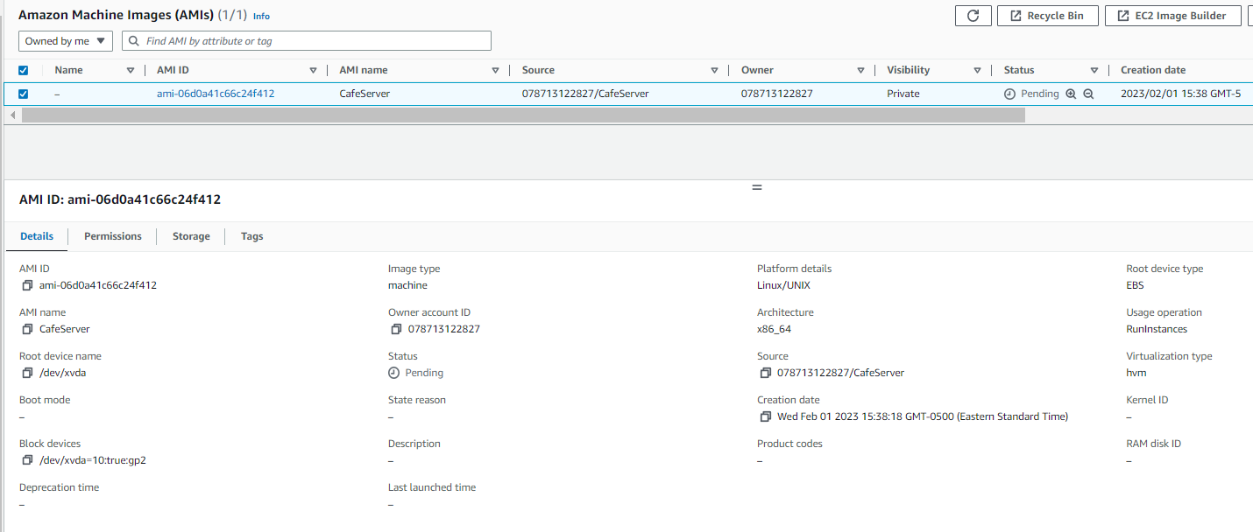
Go to the amis page and wait for the ami to become available

Slide 49
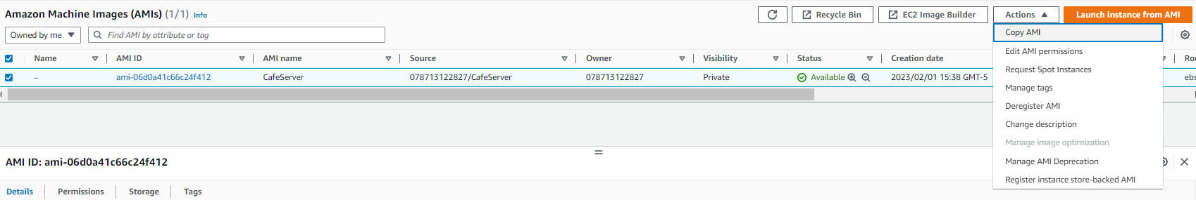
Now we need to launch ec2 instance in a different region using the ami but it would not be available as ami is region locked, hence we need to copy the ami in target region

Slide 50
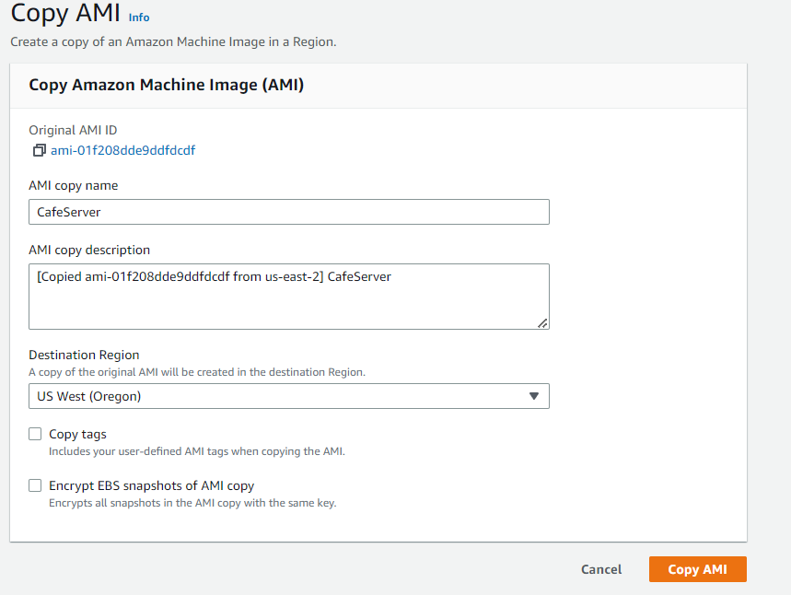
Click on copy ami after selecting the destination region

Slide 51
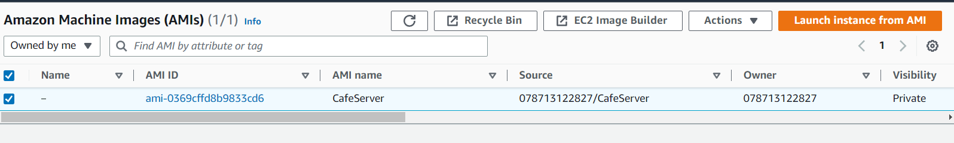
Launch instance from the Oregon ami

Slide 52
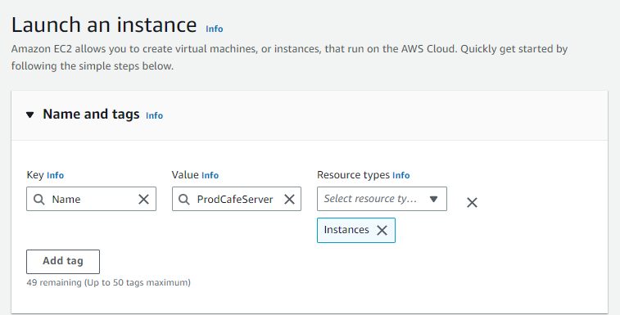
Set name for instance

Slide 53
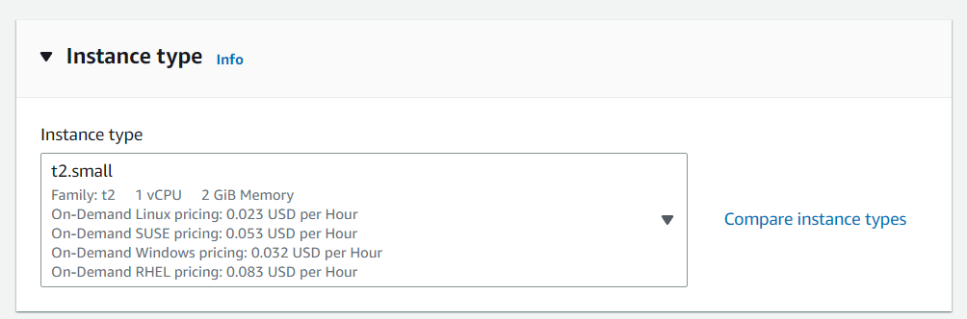
Instance size as t2.small

Slide 54
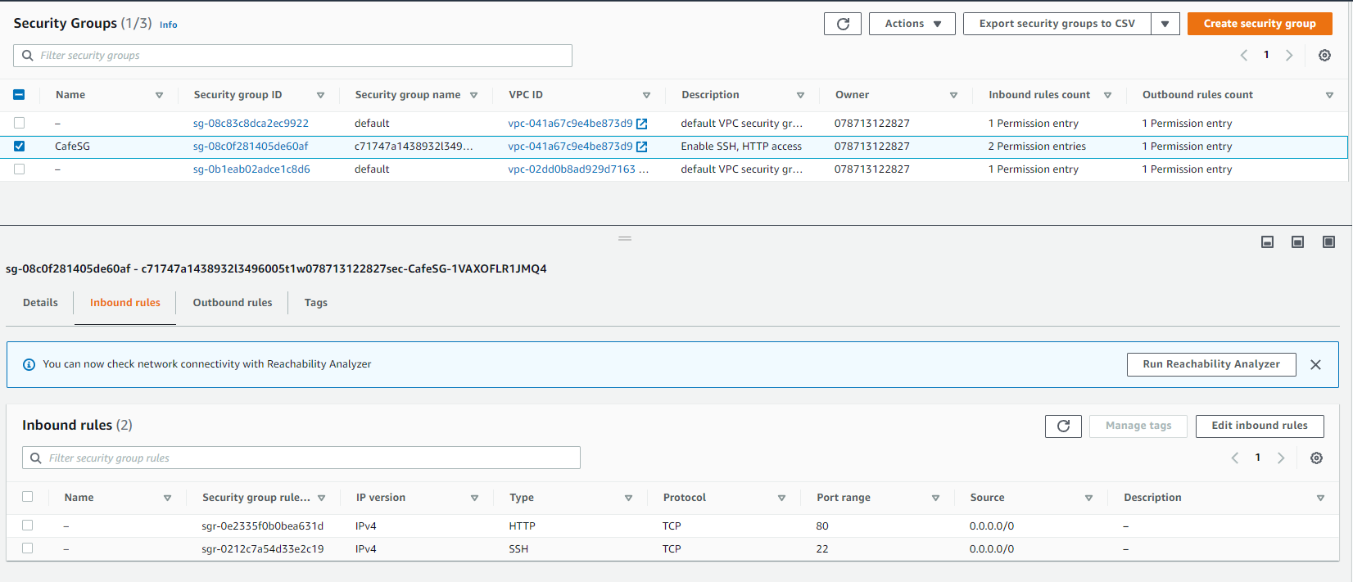
cafesg security group and enable port 22 and port 80 tcp from anywhere

Slide 55
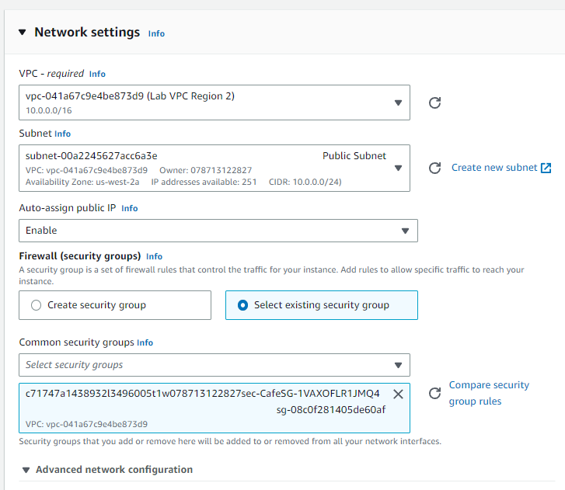
Network settings

Slide 56
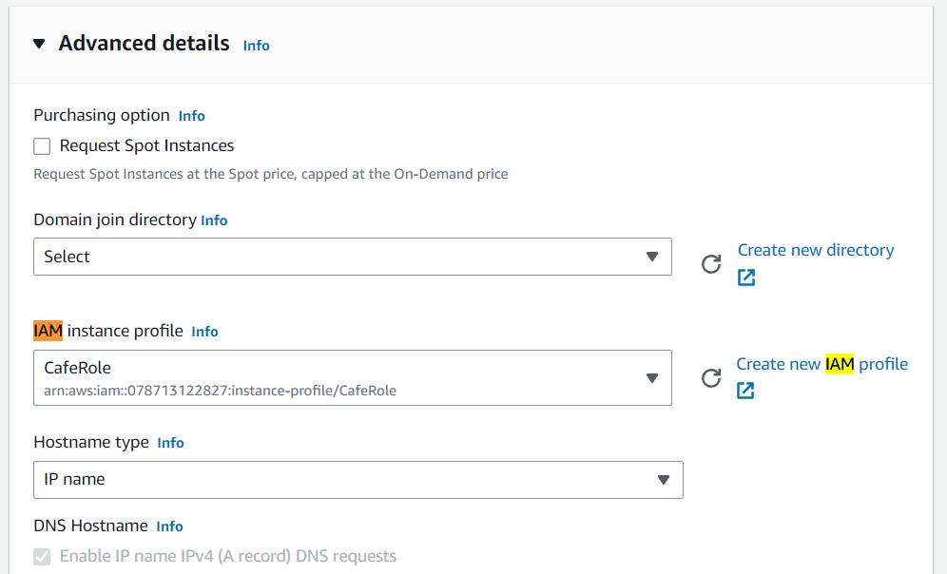
Set iam instance profile as caferole

Slide 57
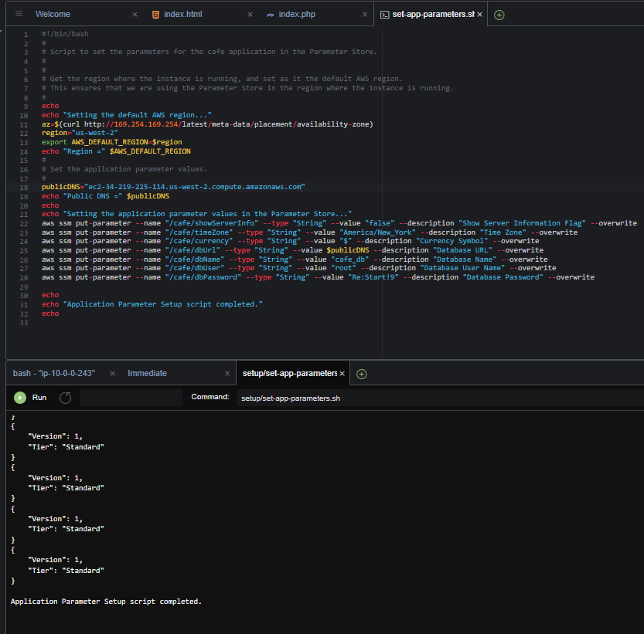
Change the set-app-parameters.sh as mentioned in labs and then run it

Slide 58
Task 7: Verifying the new café instance

Slide 59
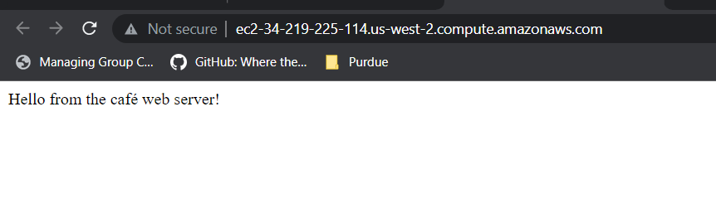
The web server in Oregon is responding to the request

Slide 60

When we run the website with /café entire website should load up

Slide 61

Website ordering is working

Slide 62
THANK YOU
Amrit Singh

